Slide 1

Neural Networks: The Backpropagation Algorithm
Annette Lopez Davila

Slide 2
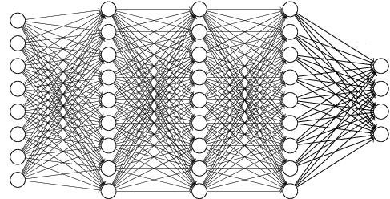
What are Neural Networks
Neural Networks are biologically inspired algorithms that can learn patterns and find connections in data
Data including images, sounds, texts, and time series are translated into tensors
Types of Problems NN’s solve: Classification, clustering, prediction

Slide 3
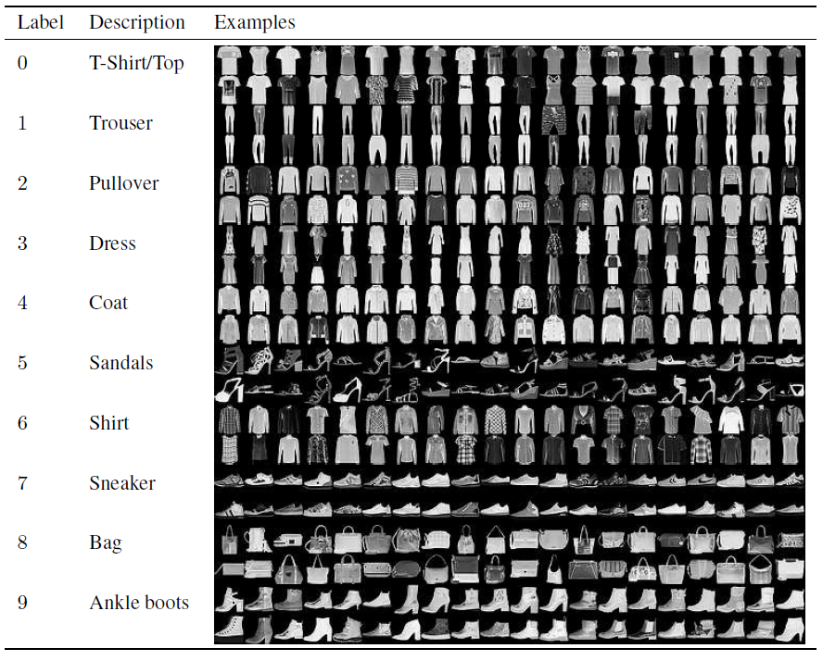
Fashion MNIST Dataset

Slide 4
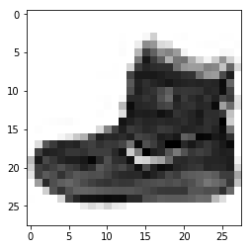
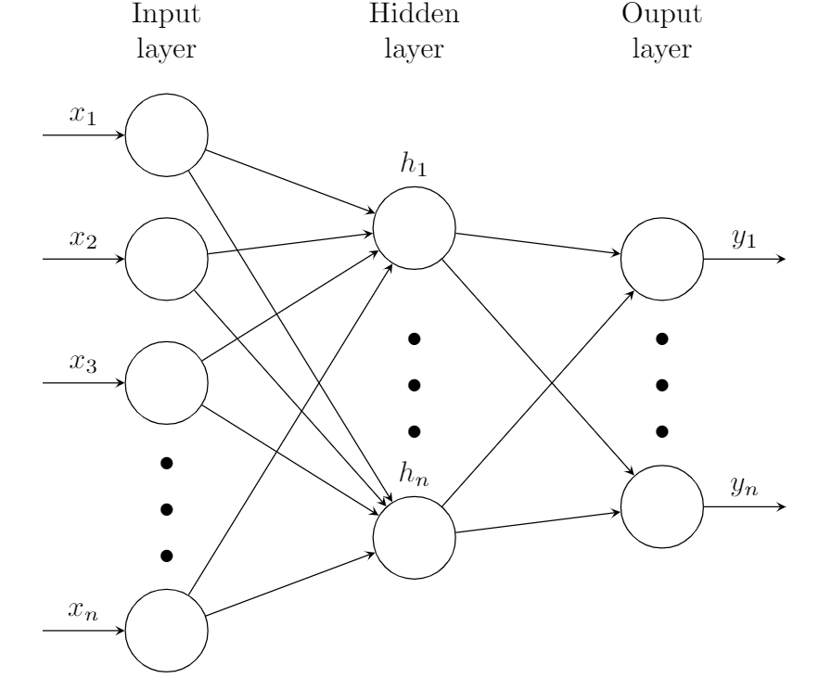




Structure: Neurons
28x28 Image with 784 neurons
Neurons: Units that hold numbers
Activation number between 0 and 1 that describes how much the pixel is lit up
0 represents black pixels, 1 represents white pixels
0.4
0.8
0.5
0.1
$$a_{1}$$
$$a_{2}$$
$$a_{3}$$
$$a_{n}$$

Slide 5




Structure: Layers
784 Neurons 10 Neurons
The 784 neurons make up the first layer of the network
The last layer describes how much an image corresponds with each label
Last layer represents numbers 0-9
Hidden Layers break down the elements of the images
Edge recognition, vertical lines, loops
$$a_{1}$$
$$a_{2}$$
$$a_{3}$$
$$a_{n}$$

Slide 6

Neurons and Parameters
A neuron is like a function; it takes input and delivers one output number
Thus, the entire network is a massive function with thousands of parameters
Each activation number is multiplied by a weight
For each node in a hidden layer, the weighted sum is computed
$$z_{i}=w_{1}a_{1}+w_{2}a_{2}+⋯w_{n}a_{n}$$
$where i=\left[1, \# of neurons in hidden layer\right]$ and n=# of activation numbers
The weighted inputs are all added together with some bias in order to adjust the output (become meaningfully active)
$$z_{i}=w_{1}a_{1}+w_{2}a_{2}+⋯w_{n}a_{n}+b$$
The weighted sum is a linear function….that limits us greatly!

Slide 7
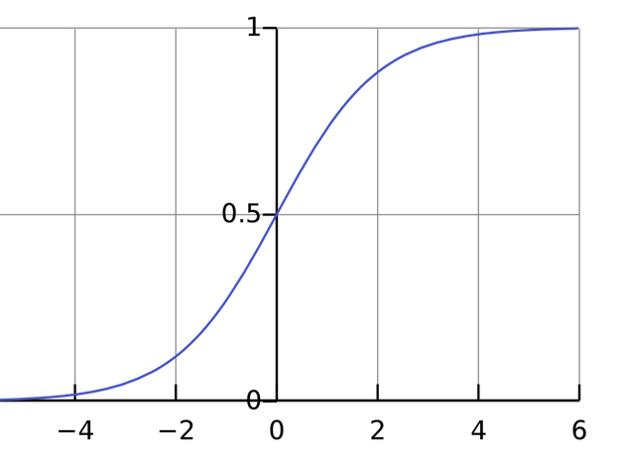
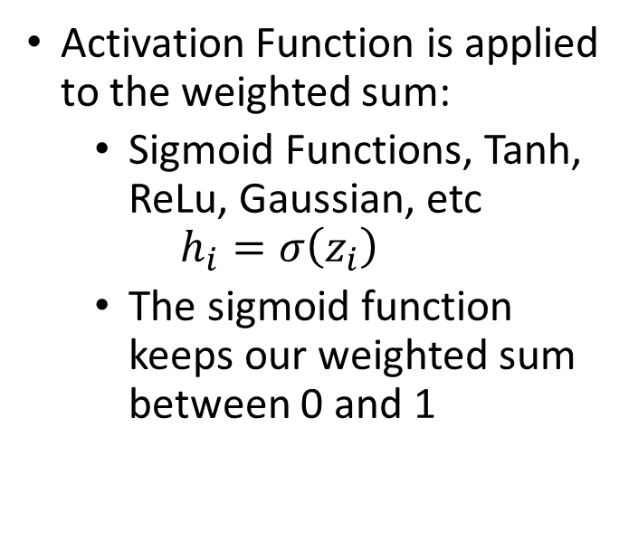
Activation Functions
Activation Function is applied to the weighted sum:
Sigmoid Functions, Tanh, ReLu, Gaussian, etc
$$h_{i}=σ\left(z_{i}\right)$$
The sigmoid function keeps our weighted sum between 0 and 1

Slide 8
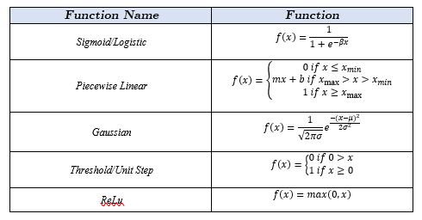

Slide 9
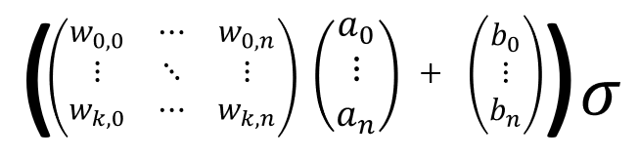




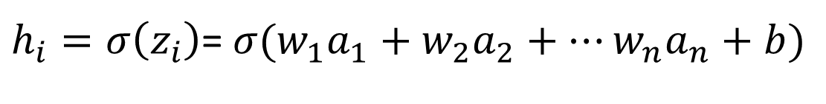



$h_{i}=σ\left(z_{i}\right)$= $σ(w_{1}a_{1}+w_{2}a_{2}+⋯w_{n}a_{n}+b)$
a
$$h^{1}$$
$$a_{1}$$
$$a_{2}$$
$$a_{3}$$
$$\overline{h^{1}}=σ\left(\vec{w}\vec{a}+\vec{b}\right)$$
$$a_{n}$$

Slide 10
Machine Learning
A neural network is a connection of many of these mini functions
Some combinations of weights and biases will give us more accurate answers than others
We could find all the correct weights and biases by hand by using a lot of calculus
Machine Learning: finding the optimal weights and biases with a computer

Slide 11
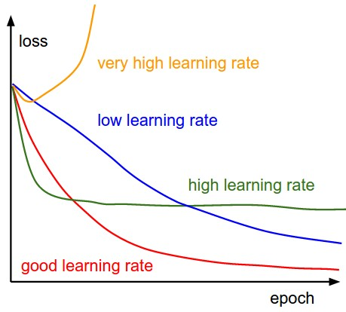
Learning: The Loss Function
Loss/Cost Function: Tells the machine how far away the combination of weights and biases is from the optimal solution
The machine will learn over several epochs
Once it reaches the optimal, it will begin to overfit and the accuracy will decrease

Slide 12

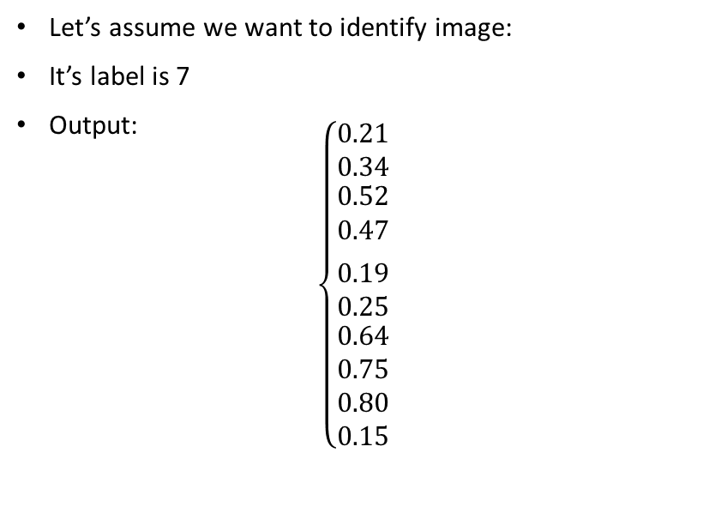
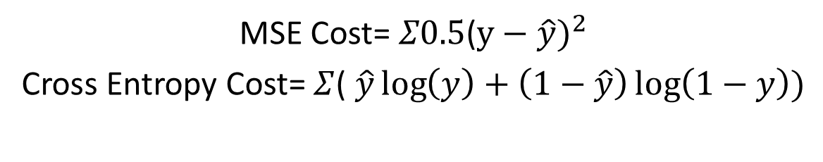

Loss Function
Desired Output:
$$\left\{\begin{aligned}0 \\ 0 \\ 0 \\ 0 \\ 0 \\ 0 \\ 0 \\ 1 \\ 0 \\ 0\end{aligned}\right.$$
Let’s assume we want to identify image:
It’s label is 7
Output:
$$\left\{\begin{matrix}0.21 \\ 0.34 \\ \begin{aligned}0.52 \\ 0.47\end{aligned} \\ \\ \begin{aligned}0.19 \\ 0.25\end{aligned} \\ 0.64 \\ 0.75 \\ 0.80 \\ 0.15\end{matrix}\right.$$
MSE Cost= $Σ0.5$($y−\hat{y})^{2}$
Cross Entropy Cost= $Σ$( $\hat{y}\log\left(y\right)+\left(1−\hat{y}\right)\log\left(1−y\right))$

Slide 13
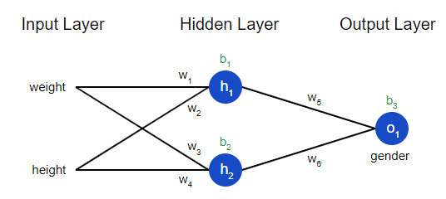

$$C\left(w_{1},w_{2},…{, w}_{h}, b_{1},…{,b}_{i}\right)$$

Slide 14
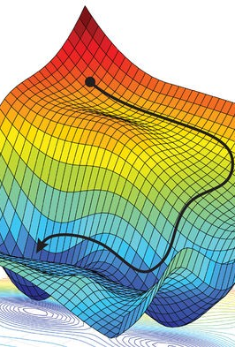
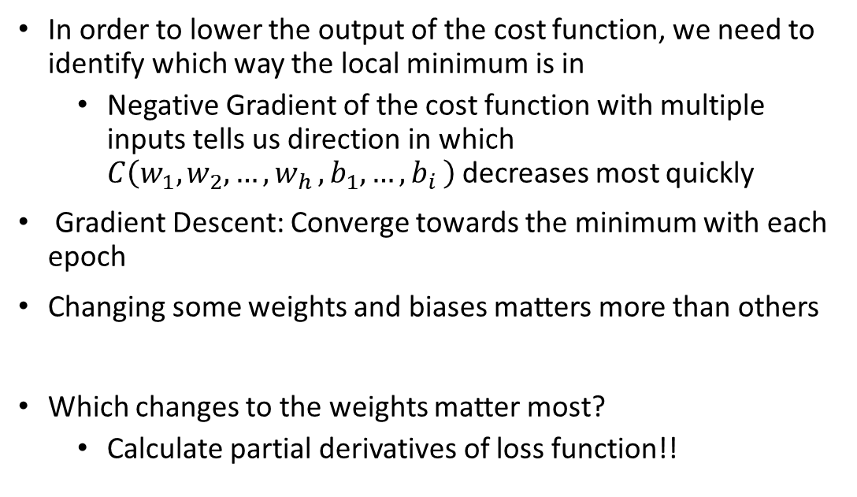
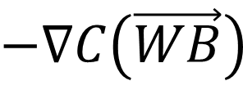
Optimizers and Gradient Descent
In order to lower the output of the cost function, we need to identify which way the local minimum is in
Negative Gradient of the cost function with multiple inputs tells us direction in which $C\left(w_{1},w_{2},…{, w}_{h}, b_{1},…{,b}_{i}\right)$decreases most quickly
Gradient Descent: Converge towards the minimum with each epoch
Changing some weights and biases matters more than others
Which changes to the weights matter most?
Calculate partial derivatives of loss function!!
$$−∇C\left(\vec{WB}\right)$$

Slide 15
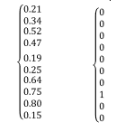
Labels Output Desired Output
Poll:
Which Output do we want to decrease more:
0.80 or 0.21?
0
1
2
3
4
5
6
7
8
9

Slide 16
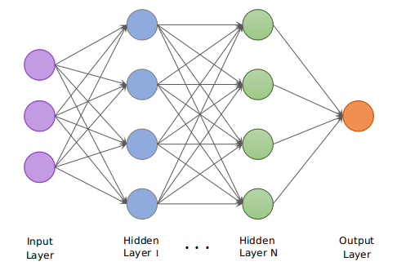
Backpropagation
We want to decrease 0.80 more than we want to decrease 0.15
The neuron containing 0.80 is the weighted sum of the previous layer, thus we can decrease the weights, biases, or the activation number of layer N-1
Hebbian Theory: The neurons in the previous layer with the most activation have the most impact on how we can raise the neuron in the final layer
Backpropagation: How to “nudge” weights and biases; the algorithm to calculate the gradient
0.80

Slide 17
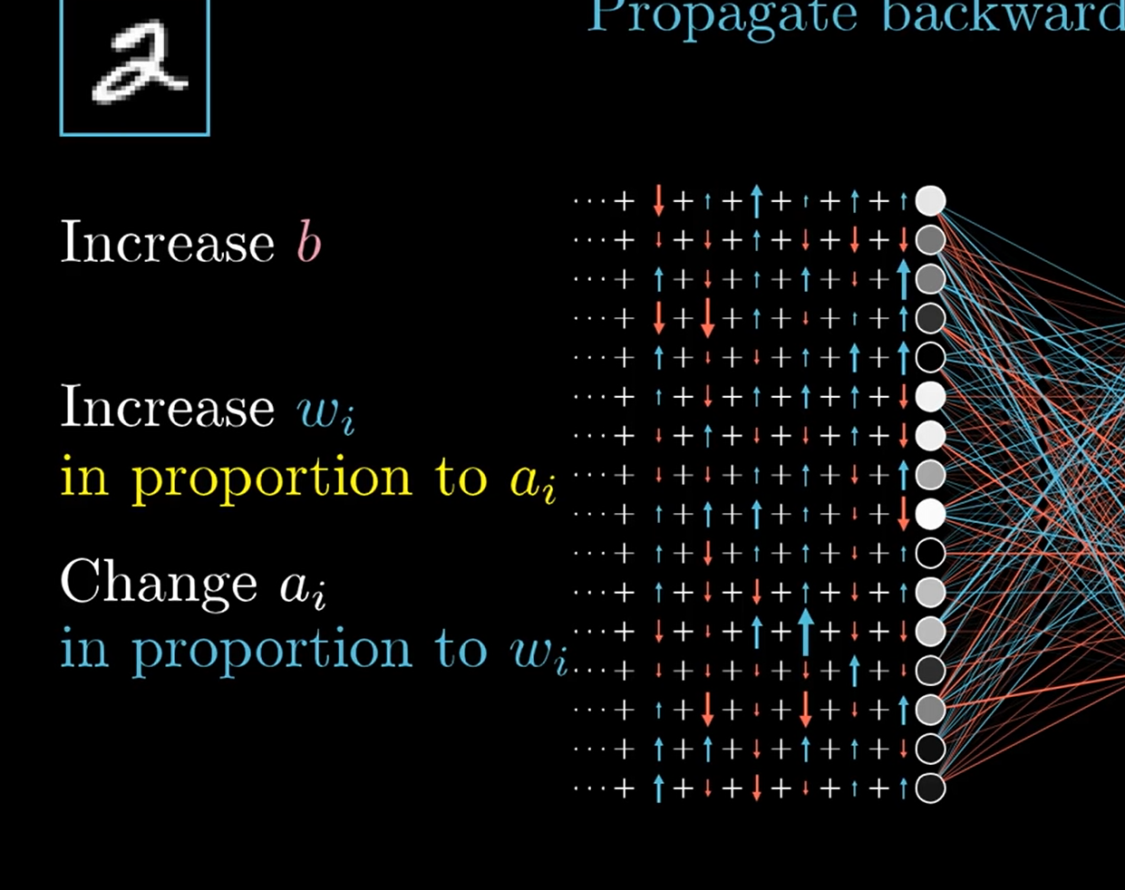

Backpropagation
This is recursively done through every single layer in the neural network
The network must also account these changes for the neurons in the output layer other than 0.8
The average of all these suggested changes to the weights and biases are proportionate to $−∇C\left(\vec{WB}\right)$

Slide 18




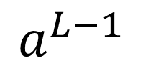
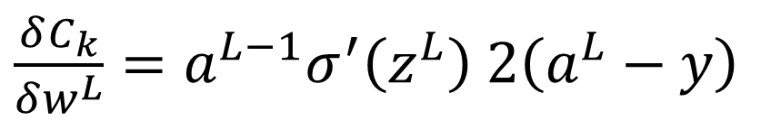



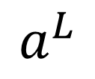
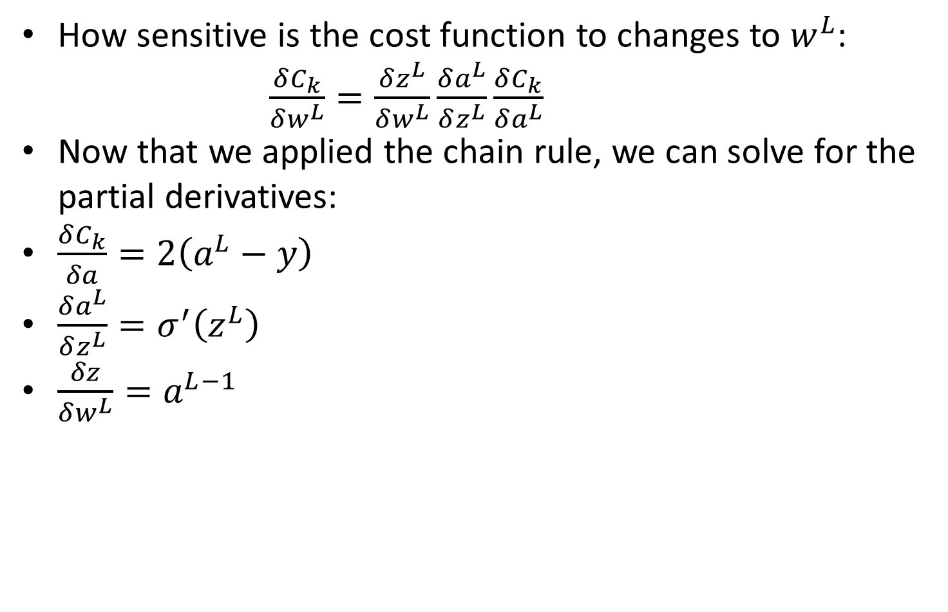


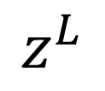
The Calculus Behind Backprop
$$z^{L}=w^{L}a^{L−1}+b^{L}$$
$0.2$4
$0.4$8
$$0.73$$
$$a^{L}=σ{(z}^{L})$$
$$C={\left(a^{L}−y\right)}^{2}$$
${ a}^{L−2} a^{L−1}$ $a^{L}$
$$w^{L}$$
$$a^{L−1}$$
$$b^{L}$$
How sensitive is the cost function to changes to $w^{L}$:
$\frac{δC_{k}}{δw^{L}}=\frac{δz^{L}}{δw^{L}}\frac{δa^{L}}{δz^{L}}\frac{δC_{k}}{δa^{L}}$
Now that we applied the chain rule, we can solve for the partial derivatives:
$\frac{δC_{k}}{δa}=2\left(a^{L}−y\right)$
$\frac{δa^{L}}{δz^{L}}=σ^{′}\left(z^{L}\right)$
$\frac{δz}{δw^{L}}=a^{L−1}$
$$z^{L}$$
$$a^{L}$$
$\frac{δC_{k}}{δw^{L}}=a^{L−1}σ^{′}\left(z^{L}\right)$ $2\left(a^{L}−y\right)$
$$C$$

Slide 19
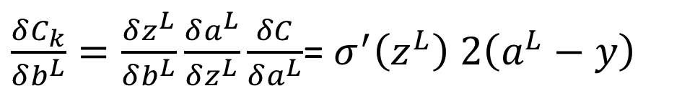


This method continues…
Derivative of Total Cost of all the examples: $\frac{δC}{δw^{L}}=\frac{1}{n}\sum_{k=0}^{n−1}{\frac{δC_{k}}{δw^{L}}}$
$∇C=\left[\begin{aligned}\frac{δC}{δw^{1}} \\ \frac{δC}{δb^{1}} \\ ⋮ \\ \frac{δC}{δw^{L}} \\ \frac{δC}{δb^{L}}\end{aligned}\right]$
$\frac{δC_{k}}{δb^{L}}=\frac{δz^{L}}{δb^{L}}\frac{δa^{L}}{δz^{L}}\frac{δC}{δa^{L}}$= $σ^{′}\left(z^{L}\right)$ $2\left(a^{L}−y\right)$
$$\frac{δC}{δb^{L}}=\frac{1}{n}\sum_{k=0}^{n−1}{\frac{δC_{k}}{δb^{L}}}$$

Slide 20








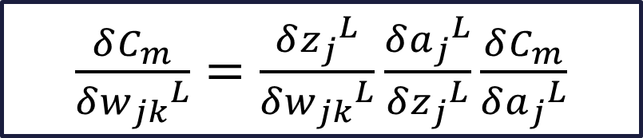
What about with more than one neuron per layer?
$$C_{m}=\sum_{j=0}^{n_{L}−1}{{\left(a_{j}^{L}−y_{j}\right)}^{2}}$$
$$a_{1}^{L−1}$$
$$a_{1}^{L}$$
$$a_{j}=σ\left(z_{j}^{L}\right)$$
$$z_{j}^{L}=…+w_{jk}^{L}a_{k}^{L−1}+…$$
$$w_{jk}^{L}$$
$$a_{k}^{L−1}$$
$$a_{j}^{L}$$
$\frac{δC_{m}}{δ{w_{jk}}^{L}}=\frac{δ{z_{j}}^{L}}{δ{w_{jk}}^{L}}\frac{δ{a_{j}}^{L}}{δ{z_{j}}^{L}}\frac{δC_{m}}{δ{a_{j}}^{L}}$
https://towardsdatascience.com/the-maths-behind-back-propagation-cf6714736abf

Slide 21
Applications of Neural Networks trained with Backpropagation/ Automatic Differentiation
Sonar Target Recognition
Zipcode Recognition/ Text Recognition
Network-controlled steering of cars
Face Recognition
Remote Sensing
Newer Research: What problems does Backprop have?

